Slide 1
Random variables

Slide 2
Motivation
If we know the starting salary of a sample of 100 newly graduates in data science, we can draw conclusions about the expected starting salary of all data science graduates.
Draw statistical conclusions from a sample of data about the entire population of interest.

Slide 3
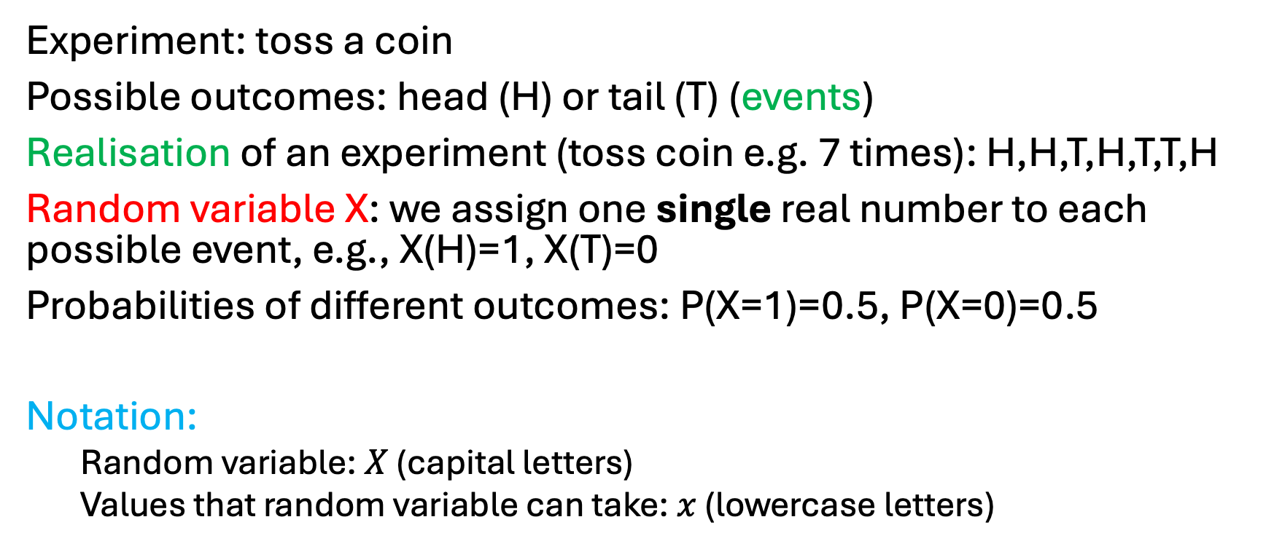
Random variable
Experiment: toss a coin
Possible outcomes: head (H) or tail (T) (events)
Realisation of an experiment (toss coin e.g. 7 times): H,H,T,H,T,T,H
Random variable X: we assign one single real number to each possible event, e.g., X(H)=1, X(T)=0
Probabilities of different outcomes: P(X=1)=0.5, P(X=0)=0.5
Notation:
Random variable: $X$ (capital letters)
Values that random variable can take: $x$ (lowercase letters)

Slide 4
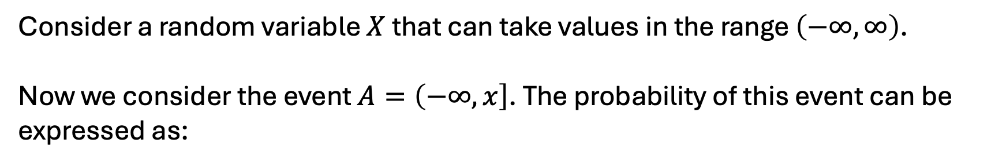
Random variables
Consider a random variable $X$ that can take values in the range $\left(−∞,∞\right)$.
Now we consider the event $A=\left(−∞,x\right]$. The probability of this event can be expressed as:

Slide 5

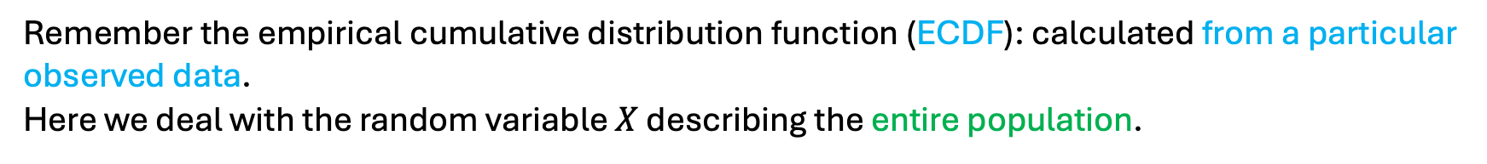
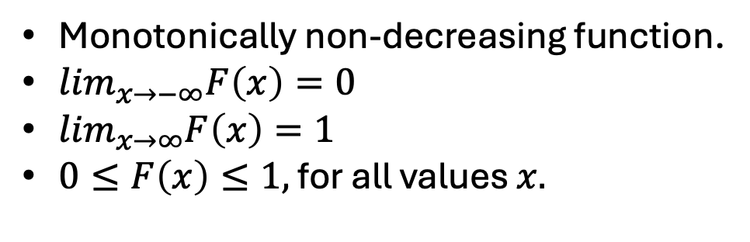
Cumulative distribution function (CDF)
Monotonically non-decreasing function.
$\lim_{x→−∞}F\left(x\right)=0$
$\lim_{x→∞}F\left(x\right)=1$
$0≤F\left(x\right)≤1,$ for all values $x.$
Remember the empirical cumulative distribution function (ECDF): calculated from a particular observed data.
Here we deal with the random variable $X$ describing the entire population.

Slide 6
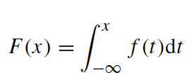

Probability Density Function (PDF): continuous variables
A random variable $X$ is continuous if there is a function $f(x)$ for all real values $x$, such that:
Probability Distribution Function
(PDF)
Cumulative Distribution Function
(CDF)

Slide 7
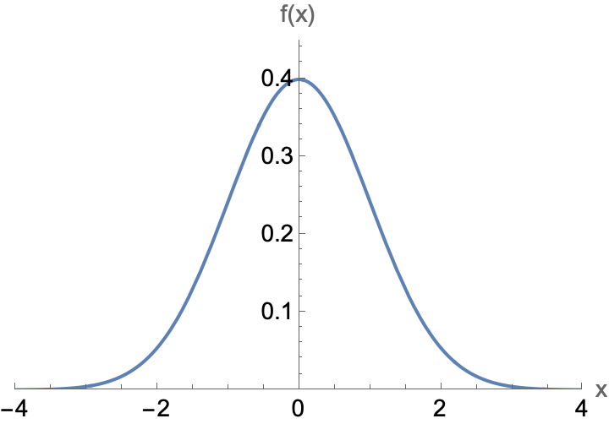
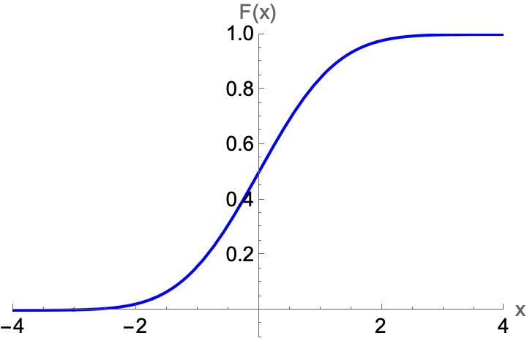
Probability Density Function (PDF)
Cumulative Density Function (CDF)

Slide 8
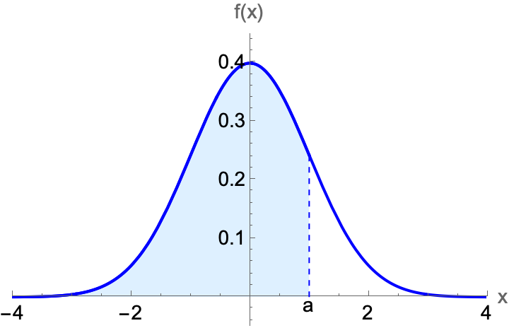
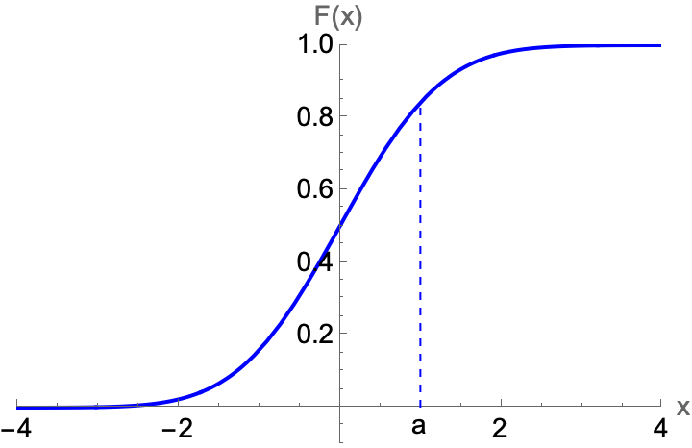
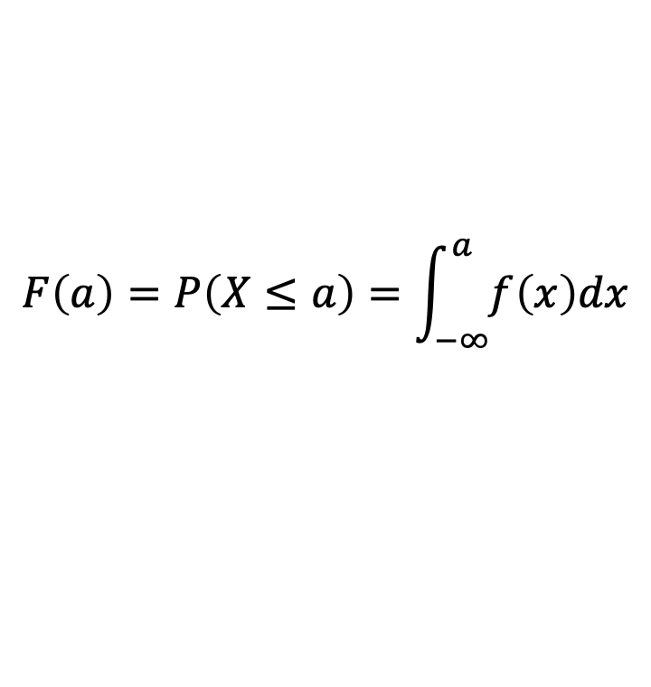
Probability Density Function (PDF)
$$F\left(a\right)=P\left(X≤a\right)=\int_{−∞}^{a}{f\left(x\right)dx}$$
blue shaded area
Cumulative Density Function (CDF)

Slide 9
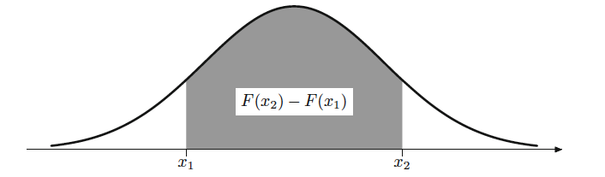
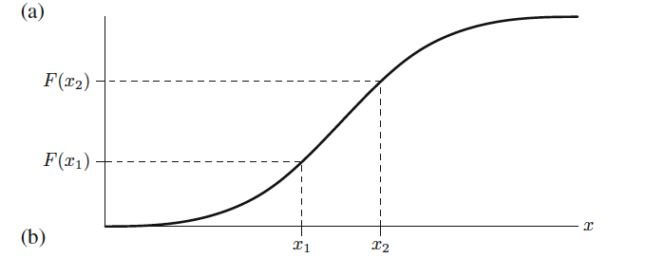

PDF
$$P\left(x_{1}≤X≤x_{2}\right)=F(x_{2})−F(x_{1})$$
CDF

Slide 10
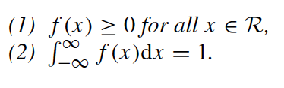
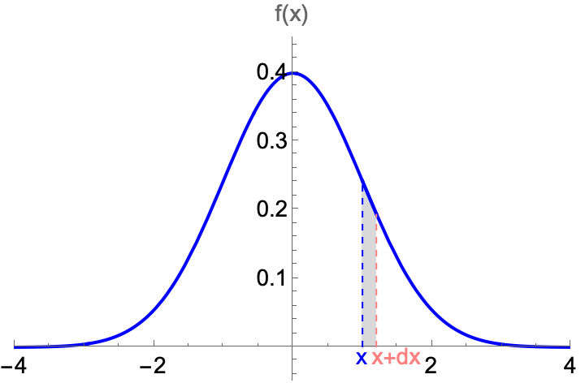

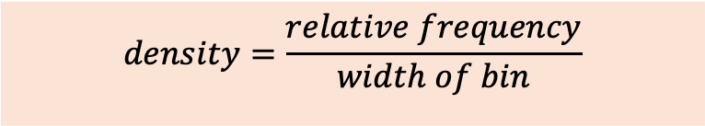

Probability Density Function (PDF): properties
$$P\left(x≤X≤x+dx\right)=f\left(x\right)dx$$
$$density=\frac{relative frequency}{width of bin}$$
$$f\left(x\right)↔$$

Slide 11

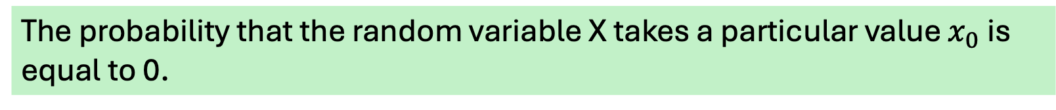
Probability Density Function (PDF)
The probability that the random variable X takes a particular value $x_{0}$ is equal to 0.

Slide 12
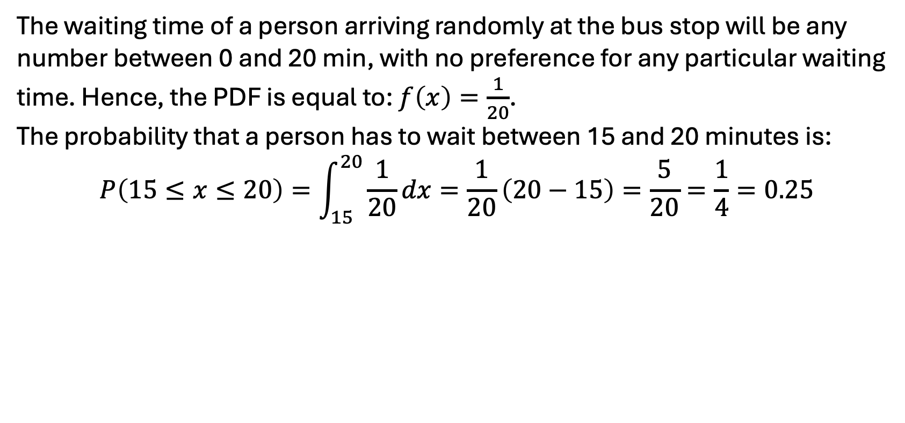
Example
A bus arrives at the Marischal College bus stop every 20 minutes. What is the probability that a person arriving randomly at the bus stop has to wait between 15 and 20 minutes?
The waiting time of a person arriving randomly at the bus stop will be any number between 0 and 20 min, with no preference for any particular waiting time. Hence, the PDF is equal to: $f\left(x\right)=\frac{1}{20}$.
The probability that a person has to wait between 15 and 20 minutes is:
$$P\left(15≤x≤20\right)=\int_{15}^{20}{\frac{1}{20}dx=\frac{1}{20}}\left(20−15\right)=\frac{5}{20}=\frac{1}{4}=0.25$$

Slide 13
Discrete variables
A random variable X is discrete if it takes values that are either finite or countable (i.e., there is a one-to-one correspondence between the possible values that X can take and the positive integers).
Examples: tossing a coin, rolling a die

Slide 14

Probability Mass Function (PMF)
The Probability Mass Function (PMF) of a discrete variable that can take k different values is:
Properties:

Slide 15
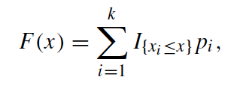
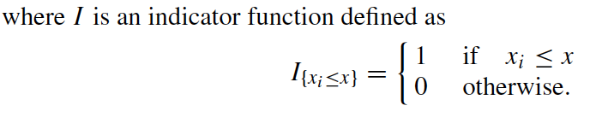

Cumulative Distribution Function (CDF): discrete random variables
$$F\left(x\right)=P(X≤x)$$

Slide 16
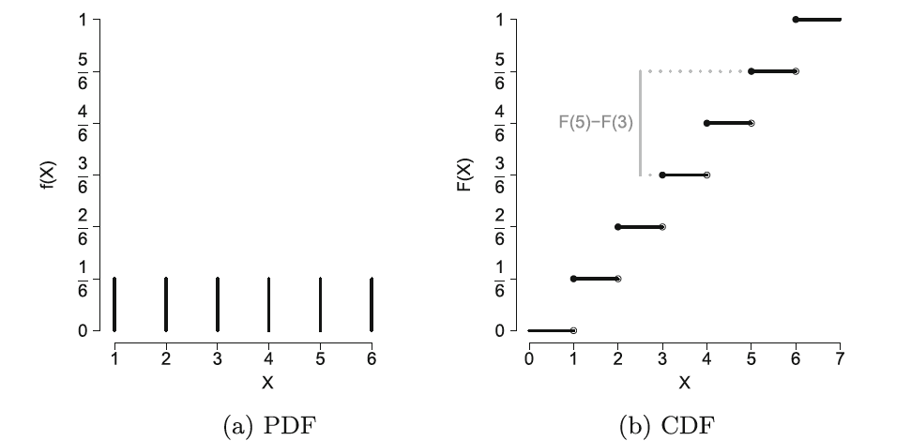
Example: rolling a die

Slide 17



Expected value
Continuous random variable with PDF $f(x)$:
Discrete random variable with PMF $p_{i}, i=1, …k$:
What is the expected value when we roll a die?

Slide 18

Expected value
Notation:
The expected value of a random variable corresponds to the arithmetic mean of the distribution of the population: it quantifies the central tendency.

Slide 19

Example
What is the expected waiting time at the bus stop at Marischal College?
$μ=E\left(X\right)=\int_{0}^{20}{x\frac{1}{20}dx=\frac{1}{20}\int_{0}^{20}{xdx=}}$ $\frac{1}{20}\left(\frac{{20}^{2}}{2}−\frac{0^{2}}{2}\right)=10 min$

Slide 20
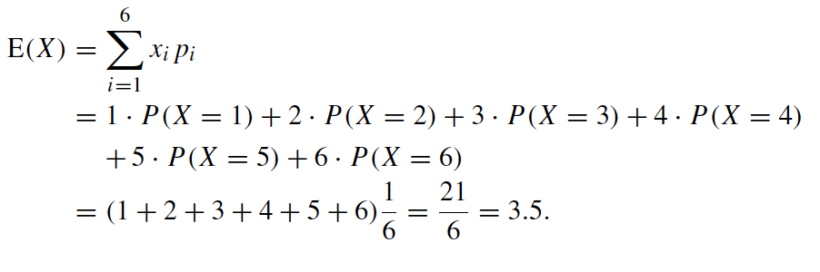
Example
What is the expected outcome when we roll a die?

Slide 21


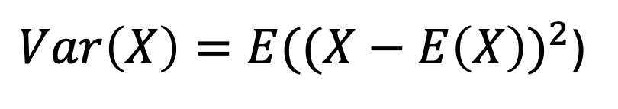
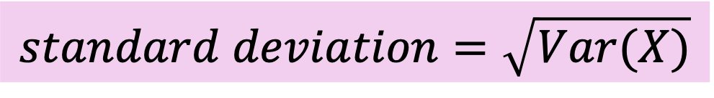
Variance and standard deviation
$Var\left(X\right)=E({(X−E\left(X\right))}^{2}$)
Variance
Continuous random variable
Discrete random variable
$$standard deviation=\sqrt{Var(X)}$$

Slide 22
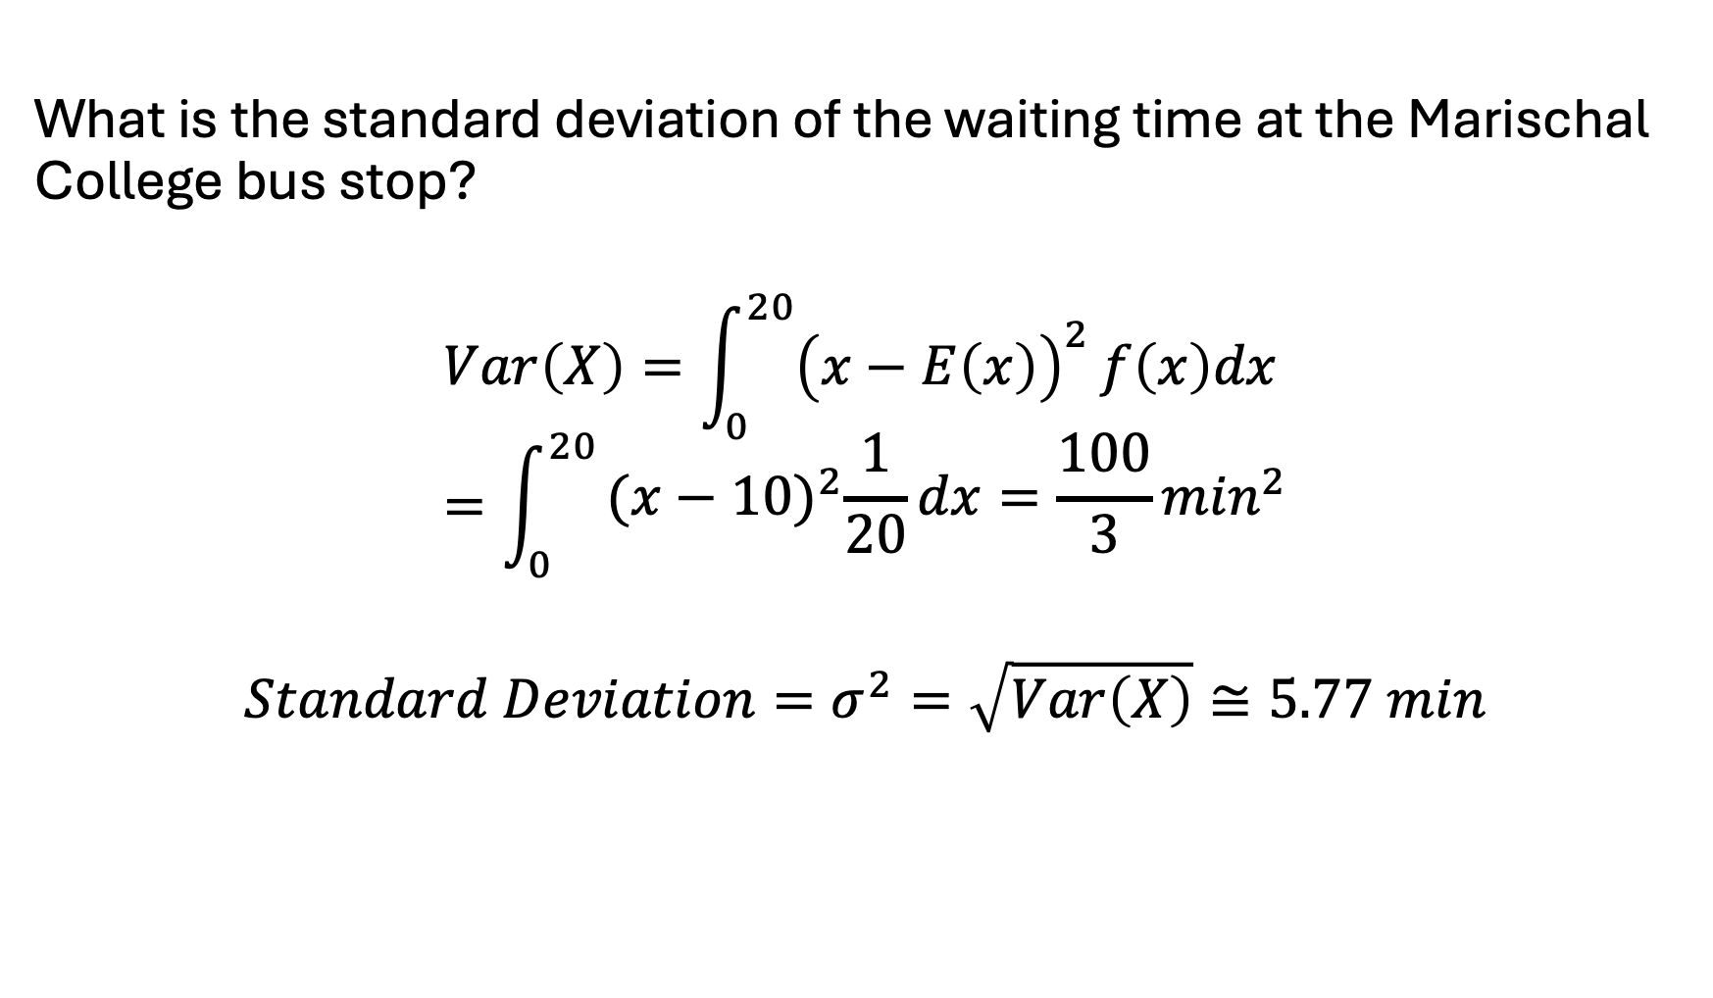
Example
What is the standard deviation of the waiting time at the Marischal College bus stop?
$$Var\left(X\right)=\int_{0}^{20}{{\left(x−E\left(x\right)\right)}^{2}}f\left(x\right)dx=\int_{0}^{20}{\begin{aligned}{(x−10)}^{2}\frac{1}{20}dx=\frac{100}{3}\min^{2} \\ \end{aligned}}$$
$$Standard Deviation=σ^{2}=\sqrt{Var\left(X\right)}≅5.77 min$$

Slide 23
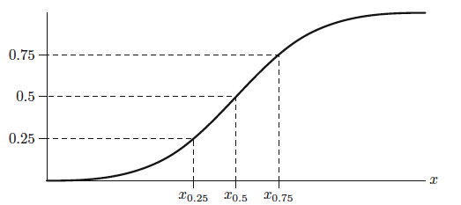
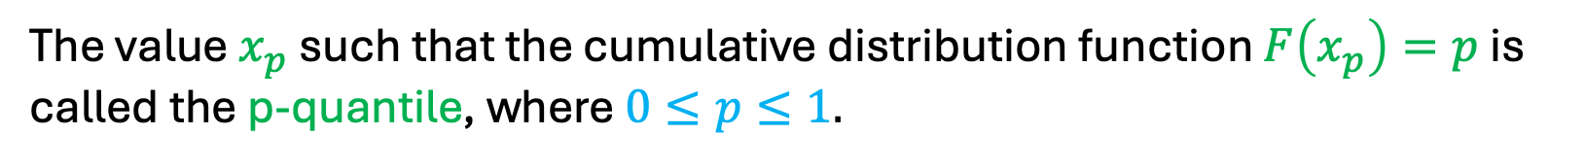

Quantiles
The value $x_{p}$ such that the cumulative distribution function $F\left(x_{p}\right)=p$ is called the p-quantile, where $0≤p≤1.$
$$F(x)$$

Slide 24
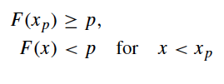
Quantiles
For discrete random variables, the p-quantile is chosen such that:

Slide 25


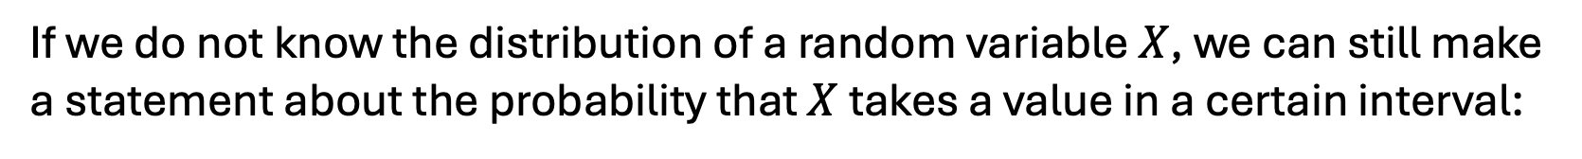
Tschebyschev’s inequality
If we do not know the distribution of a random variable $X$, we can still make a statement about the probability that $X$ takes a value in a certain interval:
Equivalently:

Slide 26
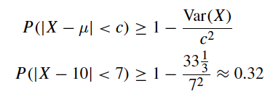
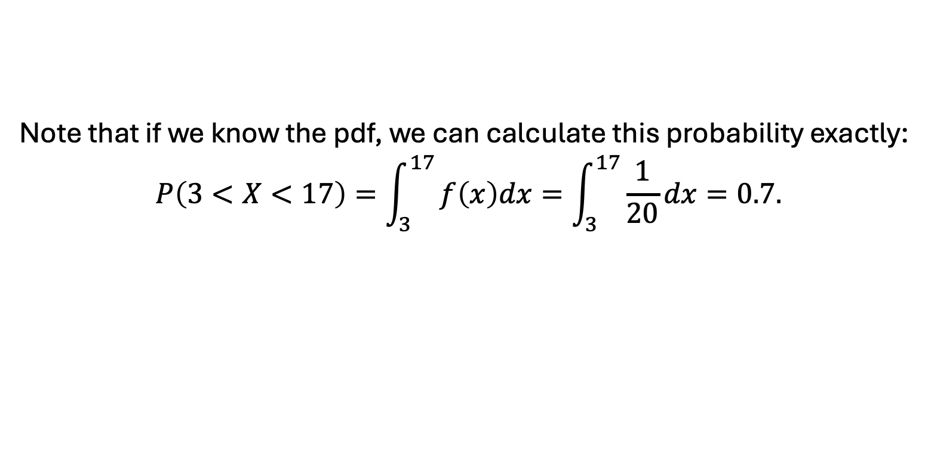
Tschebyschev’s inequality: example
What is the probability that we have to wait between 10-7=3 min and 10+7=17 min for the bus at the Marischal College bus stop?
Note that if we know the pdf, we can calculate this probability exactly:
$$P\left(3<X<17\right)=\int_{3}^{17}{f\left(x\right)dx=\int_{3}^{17}{\frac{1}{20}dx=0.7.}}$$

Slide 27
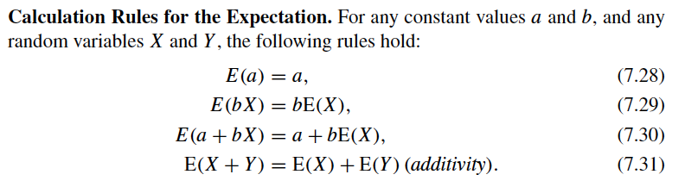
Calculation rules for the expectation

Slide 28
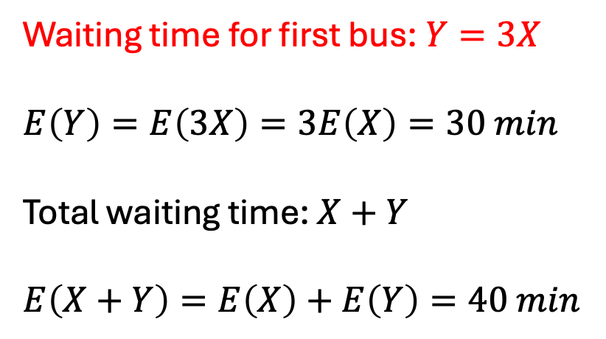
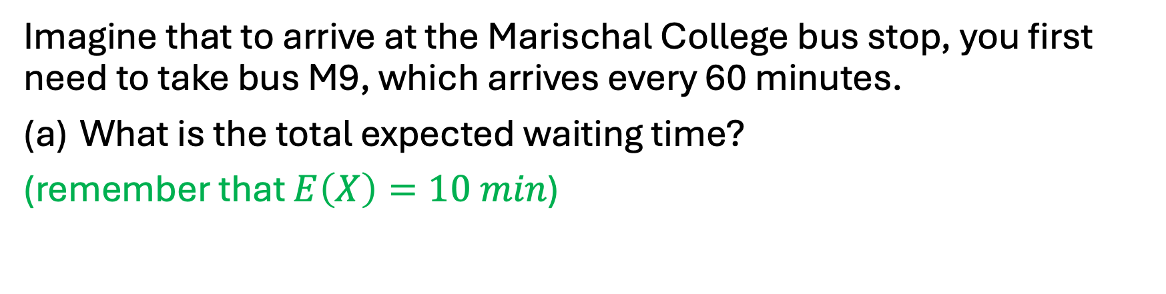
Example:
Imagine that to arrive at the Marischal College bus stop, you first need to take bus M9, which arrives every 60 minutes.
What is the total expected waiting time?
(remember that $E\left(X\right)=10 min$)
Waiting time for first bus: $Y=3X$
$$E\left(Y\right)=E\left(3X\right)=3E\left(X\right)=30 min$$
Total waiting time: $X+Y$
$$E\left(X+Y\right)=E\left(X\right)+E\left(Y\right)=40 min$$

Slide 29
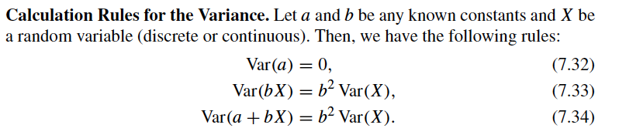
Calculation rules for the variance

Slide 30

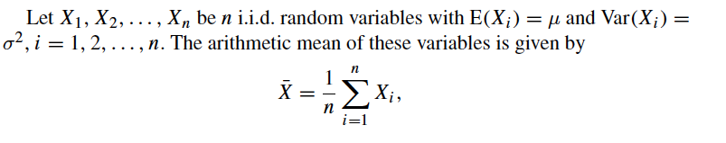
Expectation and variance of arithmetic mean: law of large numbers

Slide 31


Expectation and variance of arithmetic mean: law of large numbers
Expected value of the mean
Variance of the mean

Slide 32
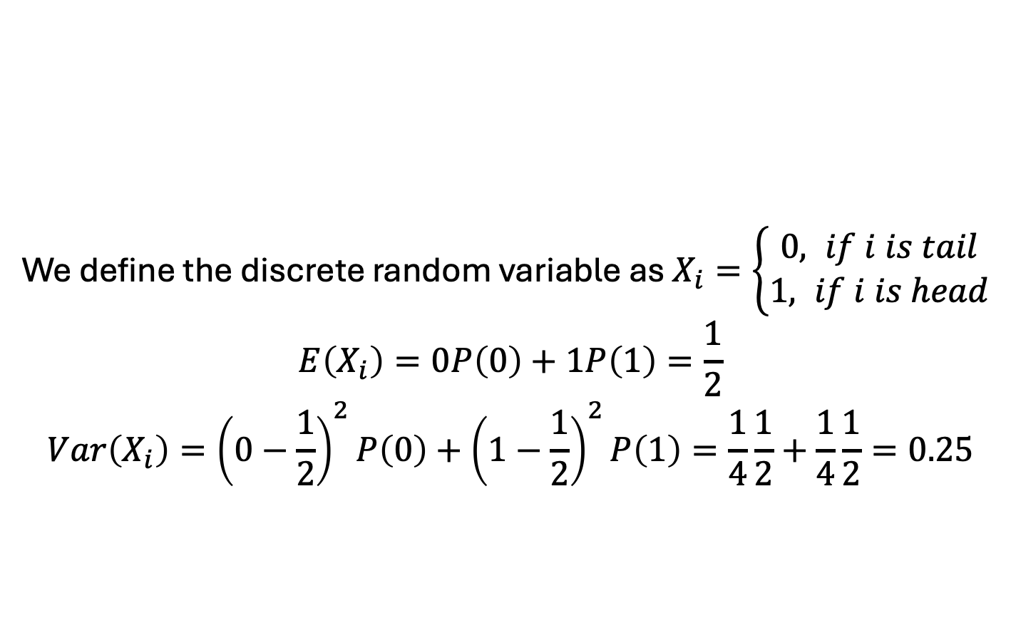
Example:
We toss a coin 10 times.
What is the expected value for the mean and what is the standard deviation of the mean?
And when we toss the coin 100 times?
We define the discrete random variable as $X_{i}=\left\{\begin{aligned}0, if i is tail \\ 1, if i is head\end{aligned}\right.$
$$E\left(X_{i}\right)=0P\left(0\right)+1P\left(1\right)=\frac{1}{2}$$
$$Var\left(X_{i}\right)={\left(0−\frac{1}{2}\right)}^{2}P\left(0\right)+{\left(1−\frac{1}{2}\right)}^{2}P\left(1\right)=\frac{1}{4}\frac{1}{2}+\frac{1}{4}\frac{1}{2}=0.25$$

Slide 33
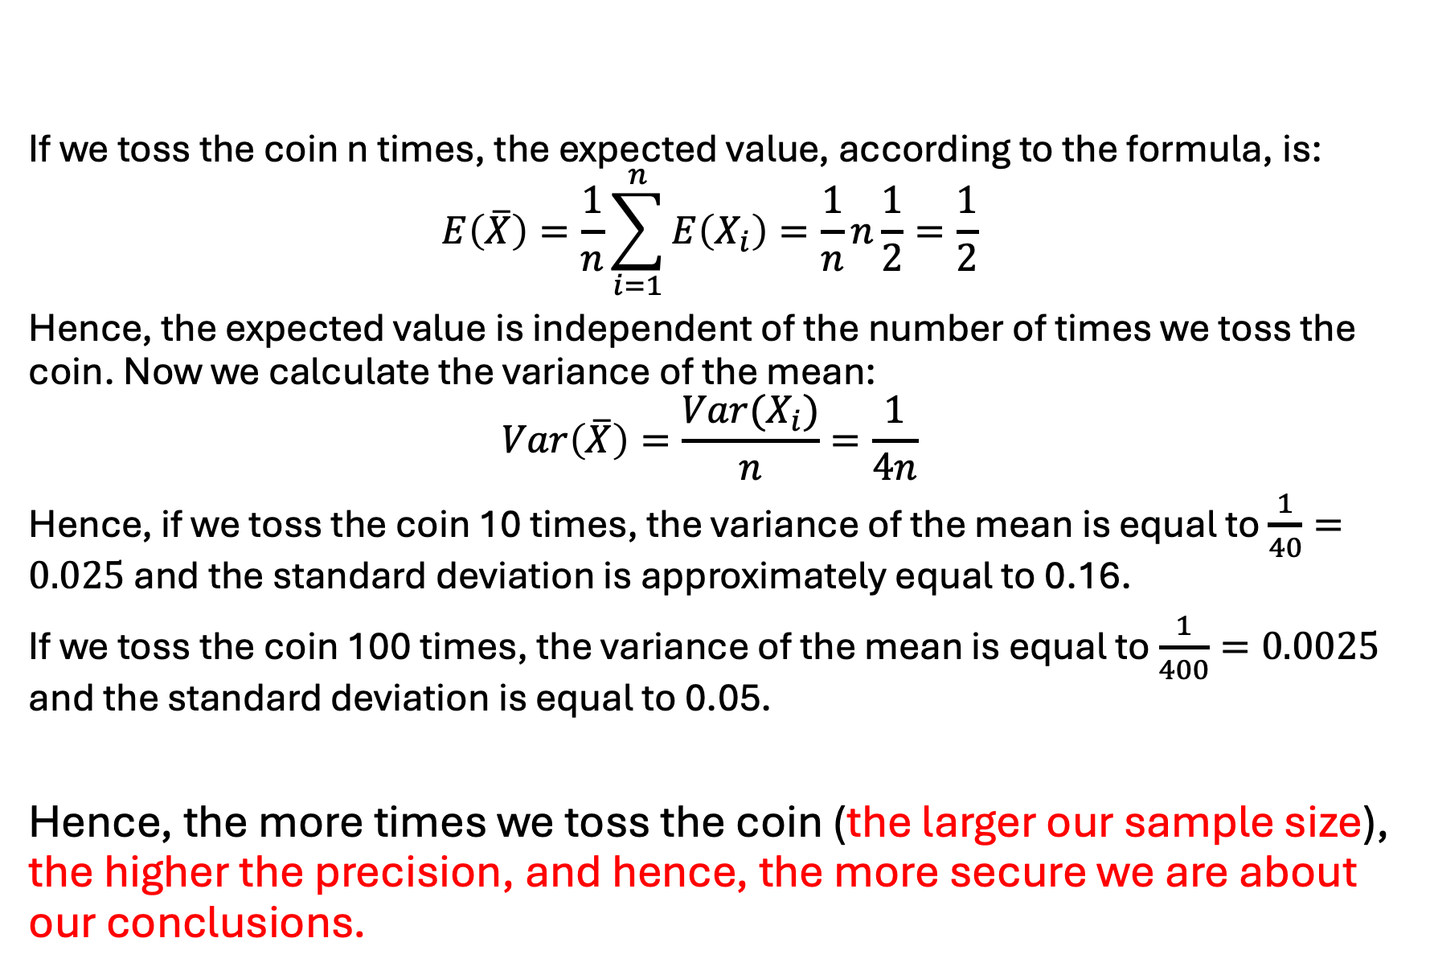
If we toss the coin n times, the expected value, according to the formula, is:
$$E\left(\overline{X}\right)=\frac{1}{n}\sum_{i=1}^{n}{E\left(X_{i}\right)=\frac{1}{n}n\frac{1}{2}=\frac{1}{2}}$$
Hence, the expected value is independent of the number of times we toss the coin. Now we calculate the variance of the mean:
$$Var\left(\overline{X}\right)=\frac{Var(X_{i})}{n}=\frac{1}{4n}$$
Hence, if we toss the coin 10 times, the variance of the mean is equal to $\frac{1}{40}=0.025$ and the standard deviation is approximately equal to 0.16.
If we toss the coin 100 times, the variance of the mean is equal to $\frac{1}{400}=0.0025$ and the standard deviation is equal to 0.05.
Hence, the more times we toss the coin (the larger our sample size), the higher the precision, and hence, the more secure we are about our conclusions.

Slide 34

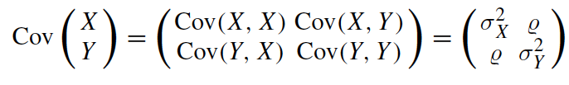
Covariance
Covariance is positive if on average, larger values of X correspond to larger values of Y.
Covariance is negative if on average, larger values of X correspond to smaller values of Y.
Covariance matrix

Slide 35


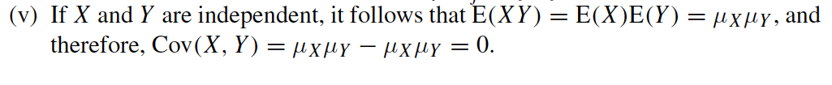
Covariance: properties

Slide 36
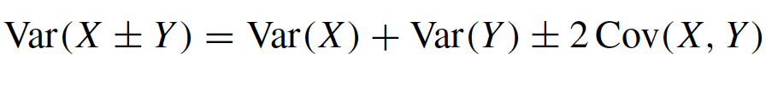
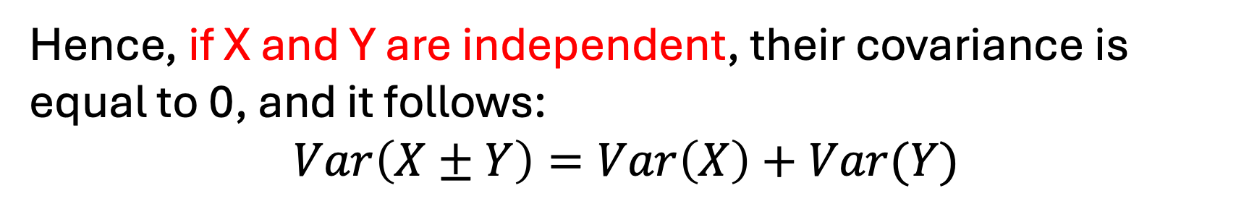
Variance of the sum of two random variables
Hence, if X and Y are independent, their covariance is equal to 0, and it follows:
$$Var\left(X±Y\right)=Var\left(X\right)+Var(Y)$$

Slide 37
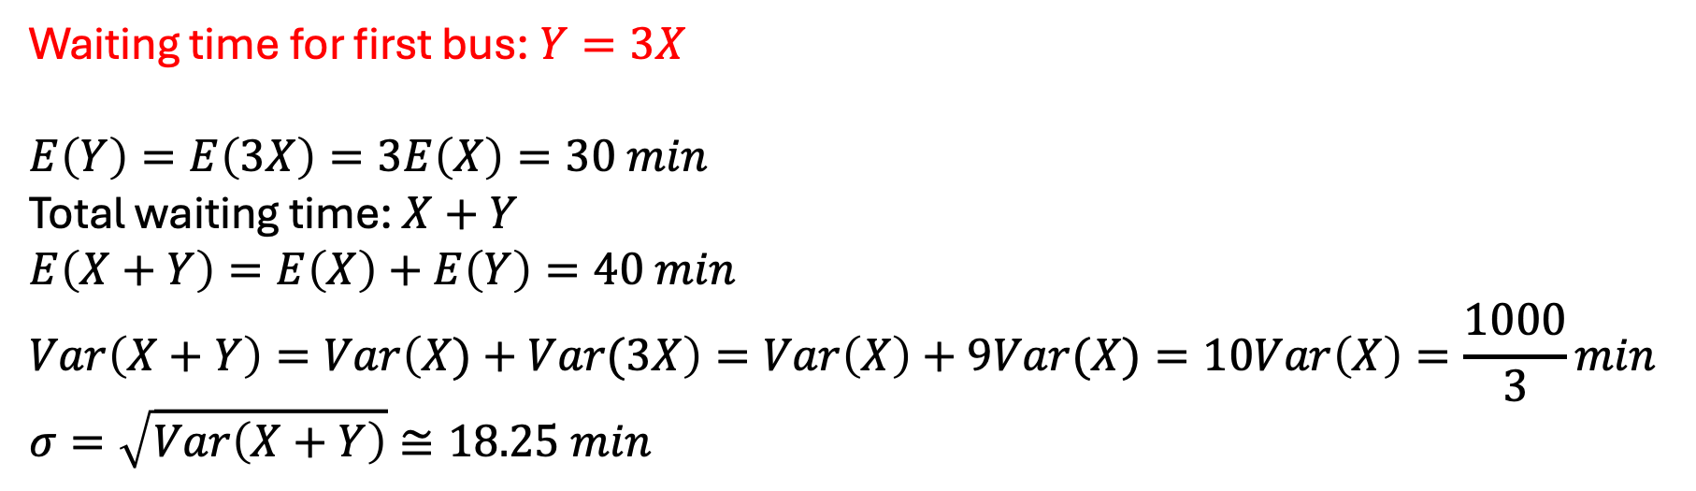
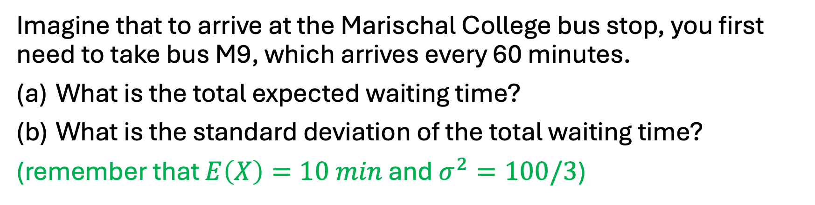
Example:
Imagine that to arrive at the Marischal College bus stop, you first need to take bus M9, which arrives every 60 minutes.
What is the total expected waiting time?
What is the standard deviation of the total waiting time?
(remember that $E\left(X\right)=10 min$ and $σ^{2}=100/3$)
Waiting time for first bus: $Y=3X$
$$E\left(Y\right)=E\left(3X\right)=3E\left(X\right)=30 min$$
Total waiting time: $X+Y$
$$E\left(X+Y\right)=E\left(X\right)+E\left(Y\right)=40 min$$
$$Var\left(X+Y\right)=Var\left(X)+Var(3X\right)=Var\left(X\right)+9Var(X)=10Var\left(X\right)=\frac{1000}{3}min$$
$$σ=\sqrt{Var\left(X+Y\right)}≅18.25 min$$
only true if X and Y independent

Slide 38
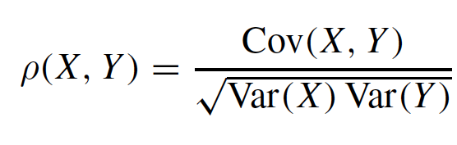

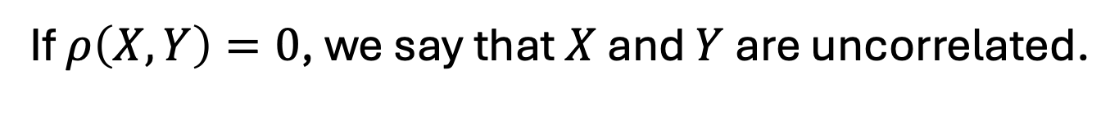
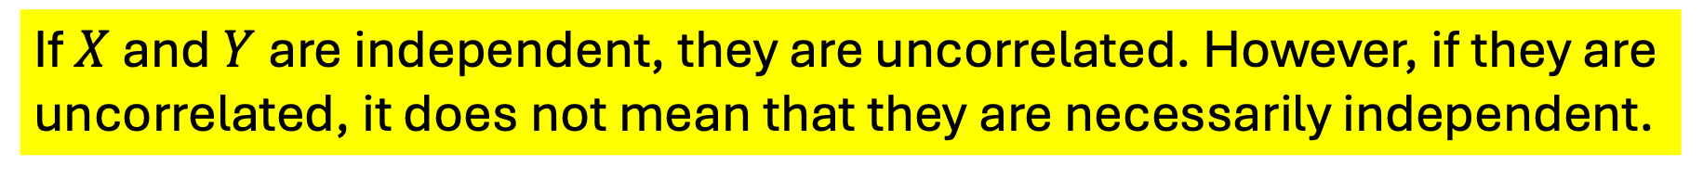
Correlation coefficient
It measures the degree of the linear relationship between X and Y.
If $ρ\left(X,Y\right)=0$, we say that $X$ and $Y$ are uncorrelated.
If $X$ and $Y$ are independent, they are uncorrelated. However, if they are uncorrelated, it does not mean that they are necessarily independent.

